Slide 1
CSC2210 OPERATING SYSTEMS I
The File Manager

Slide 2
The File Manager

Slide 3
The File Manager
The File Manager (the file management system) is the software responsible for creating, deleting, modifying, and controlling access to files—as well as for managing the resources used by the files.
The File Manager provides support for libraries of programs and data close collaboration with the Device Manager.

Slide 4
The File Manager Contd.
The File Manager has a complex job. It’s in charge of the system’s physical components, its information resources, and the policies used to store and distribute the files.
To carry out its responsibilities, it must perform these four tasks:
Keep track of where each file is stored.
Use a policy that will determine where and how the files will be stored, making sure to efficiently use the available storage space and provide easy access to the files.
Allocate each file when a user has been cleared for access to it and then track its use.
Deallocate the file when the file is to be returned to storage and communicate its availability to others that may be waiting for it.

Slide 5
Definitions

Slide 6
Definitions
A field is a group of related bytes that can be identified by the user with a name, type, and size.
A record is a group of related fields.
A file is a group of related records that contains information to be used by specific application programs to generate reports.
A database is a group of related files that are connected at various levels to offer flexible access to the data stored in it.
Directories (also known as folders) are special files that contain listings of filenames and their attributes.

Slide 7
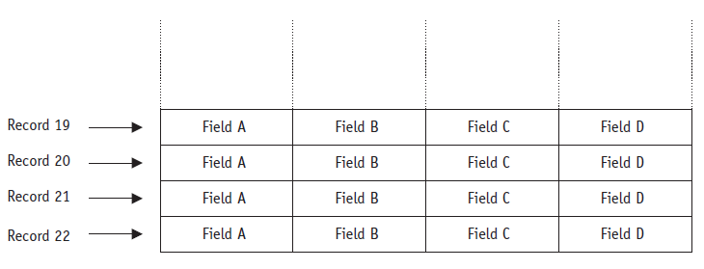
Field, Record and File

Slide 8
File System

Slide 9
File System
File System refers to the structure and logic rules used to manage the groups of data and their names.
The file system controls how data is stored and retrieved without which the data placed in a storage medium would be one large body of data with no way to tell where one piece of data starts, where it ends and the next begins.

Slide 10
File Naming
A file’s name can be much longer than it appears. Depending on the File Manager, it can have from two to many components.
The two components common to many filenames are a relative filename and an extension.

Slide 11
File Naming Contd.
The OS structures the files, names them, and protects them.
File system can be seen in two perspective:
User perspective – how we name a file, protect it and organize the files.
Implementation perspective – they are organized on disk.

Slide 12
File Attributes
Name: human readable information.
Identifier: uniquely identify files on the storage media.
Location: points to the file location on the disk.
Type: required for systems that support various file type.
Owner
Size: attribute that keeps the current size of the file.
Date and time of creationg: used for protection, security and monitoring.
Max record size

Slide 13
Directories
Directories, also known as folders are files which are used to organize other files.
The directory structure is the organization of files into a hierarchy of folder.

Slide 14
Directory Structures
Single-level directory structure: this has only one directory which is called the root directory.
The users are not allowed to create subdirectories under the root directory. All the files created by the several users are present in the root directory only.
There is one drawback of Single-level directory structure, a user cannot use the same file name used by another user in the system.

Slide 15
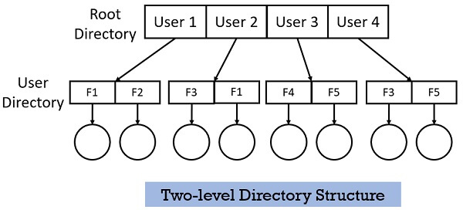
Directory Structure Contd.
Two-level directory structure, the users create directory directly inside the root directory. But once a user creates such directory, further he cannot create any subdirectory inside that directory.

Slide 16
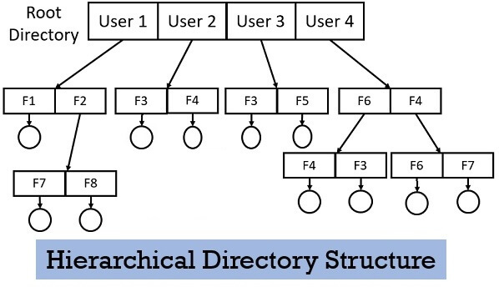
Directory Structure Contd.
Hierarchical Directory Structure: the users can create directories under the root directory and can also create sub-directories under this structure.
As the user is free to create many sub-directories, it can create different sub - directories for different file types.

Slide 17
Directory Operations
Create: creates directory
Delete: deletes a directory
Opendir: opens a directory
Closedir: closes directory
Readdir: returns the next entry in open directory
Link: links file to another directory

Slide 18
Path names
Paths can be either absolute or relative
Absolute: is the long name that includes all path information that appears in directory listings and folders
Relative: is the name without path information that appears in directory listings and folders

Slide 19
Record Format
All files are composed of records. When a user gives a command to modify the contents of a file, it’s a command to access records within the file. Within each file, the records are all presumed to have the same format: they can be of fixed length or of variable length.

Slide 20
Fixed – length Records
Fixed-length records are the easiest to access directly. The critical aspect of fixed-length records is the size.
If it’s too small to hold the entire record, then the data that is leftover is truncated, thereby corrupting the data.
But if the record size is too large— larger than the size of the data to be stored—then storage space is wasted.

Slide 21
Variable – length Records
Variable-length records don’t leave empty storage space and don’t truncate any characters, thus eliminating the two disadvantages of fixed-length records. But while they can easily be read (one after the other sequentially), they’re difficult to access directly because it’s hard to calculate exactly where each record is located.

Slide 22
Physical File Organization

Slide 23
Physical File Organizations
The physical organization of a file has to do with the way records are arranged and the characteristics of the medium used to store it.

Slide 24
Sequential Record Organization
Sequential record organization is by far the easiest to implement because records are stored and retrieved serially, one after the other. To find a specific record, the file is searched from its beginning until the requested record is found.

Slide 25
Direct Record Organization
A direct record organization uses direct access files, which, of course, can be implemented only on DASDs—direct access storage devices.
Records are identified by their relative addresses—their addresses relative to the beginning of the file. These logical addresses are computed when the records are stored and then again when the records are retrieved.
These files give users the flexibility of accessing any record in any order without having to begin a search from the beginning of the file to do so. It’s also known as “random organization,” and its files are called “random access files.”

Slide 26
Indexed Sequential R Organization
Indexed sequential record organization combines the best of sequential and direct access.
It’s created and maintained through an Indexed Sequential Access Method (ISAM) application.

Slide 27
File Access Methods

Slide 28
Access Methods
Access methods are dictated by a file’s organization; the most flexibility is allowed with indexed sequential files and the least with sequential.

Slide 29
Sequential Access
A file that has been organized in sequential fashion can support only sequential access to its records, and these records can be of either fixed or variable length.
It read records from the beginning and cannot skip around.

Slide 30
Direct Access
If a file is organized in direct fashion and if the records are of fixed length, it can be accessed in either direct or sequential order.
if however a file is organized in direct fashion and the records are of variable length, then it is virtually impossible to access a record directly because the address of the desired record can’t be easily computed.

